Slide 1


Hateful Meme Detection with Image-Text Based Multimodal Model
Presented by: Ruitian Wu & Yijia Xue
March 8th, 2022

Slide 2
0 1
Introduction & Related Work
CONTENT
0 2
Proposed Method
0 3
Performance Evaluation
0 4
Conclusion & Future Work

Slide 3

01
Introduction & Related Works

Slide 4
Introduction & Related Works
Related Work:
Concat BERT^{[2]}
Visual BERT^{[3][4]}
UNITER^{[5]}
Motivation for this topic：
Promote discrimination and prejudice
Increase the frequency of violent and terrorist incidents in real life
Definition of the hateful meme^{[1]}
Motivation & Background Information
Related
Work
Method
Extract important features from both text and image
Concat the multimodal features
Classify the meme with multimodal features input

Slide 5
Introduction & Related Works
Hateful
Meme
Detection
Definition of the hateful meme
A meme contains direct or indirect attack on people based on characteristics, including ethnicity, race, nationality, immigration status, religion, caste, sex, gender identity, sexual orientation, and disability or disease. We define attack as violent or dehumanizing(comparing people to non-human things, e.g. animals) speech, statements of inferiority, and calls for exclusion or segregation.A meme includes mocking hate crime is also considered hateful meme.

Slide 6
Introduction & Related Works
Related Work:
Concat BERT^{[2]}
Visual BERT^{[3][4]}
UNITER^{[5]}
Motivation for this topic：
Promote discrimination and prejudice
Increase the frequency of violent and terrorist incidents in real life
Definition of the hateful meme^{[1]}
Motivation & Background Information
Related
Work
Method
Extract important features from both text and image
Concat the multimodal features
Classify the meme with multimodal features input

Slide 7

Memes
Flow Chart for the Project
Method
Procedures
Text Feature
Extraction
Image Feature Extraction
Step1
Extract image and text features
Step2
Run unimodal classification on image and text features
Tag Extraction
Step3
Extract tag with useful hate-related information
Unimodal
Unimodal
Feature
Concatenation
Step4
Concat three channel's input: text, tag, image
Multimodal
Step5
Run multimodal classification on concatenated features.
Classification Model
Output

Slide 8

02
Proposed Methods

Slide 9
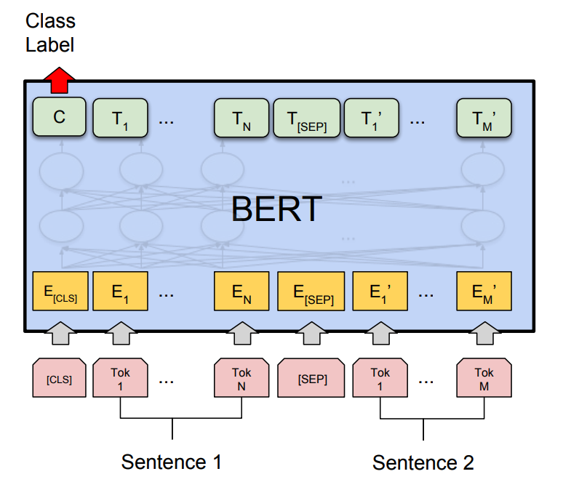
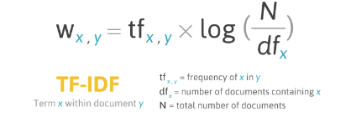
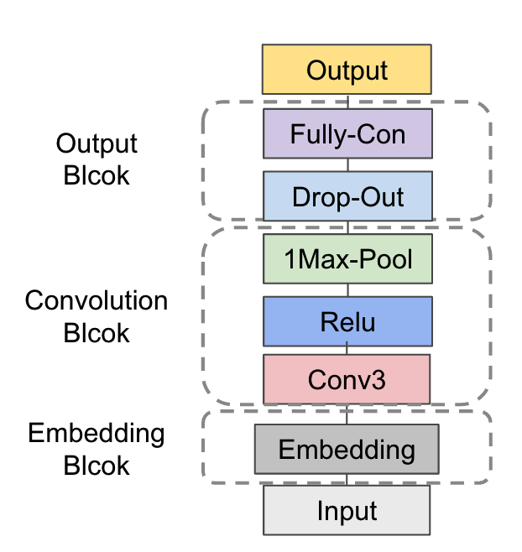
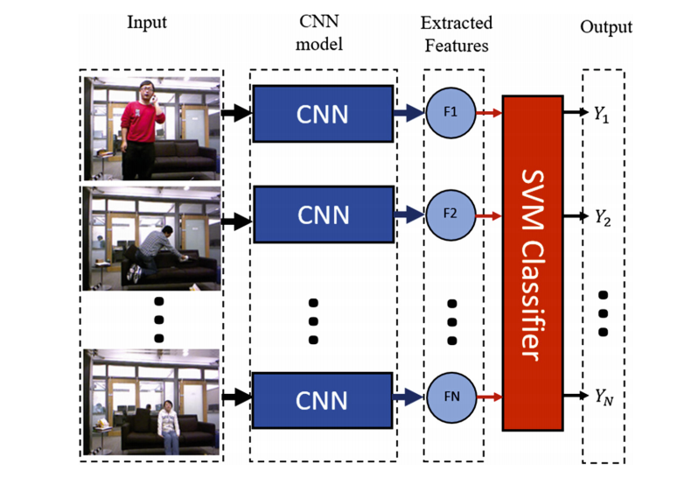
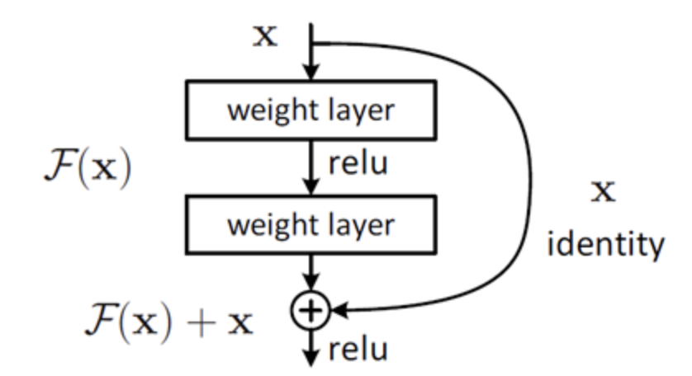
Unimodal Models
BERT Based Model^{[8]} (Text)
Tokenize and encode the whole sentence.
ResNet50 Based Model^{[9]} (Image)
Extract image features with deep CNN.
TF-IDF Based Models^{[6]} (Text)
Extract features measuring importance of each word.
Then apply some naive Machine Learning algorithms.
Text-CNN Based Model^{[7]} (Text)
Capture local features. (Better for short texts)

Slide 10
Image Features
Multimodal Model Outline
Text Features
Face
Extraction
New Tags
From BERT
Object Detection
Face Type/
Emotion Detection
Classification
From RCNN

Slide 11
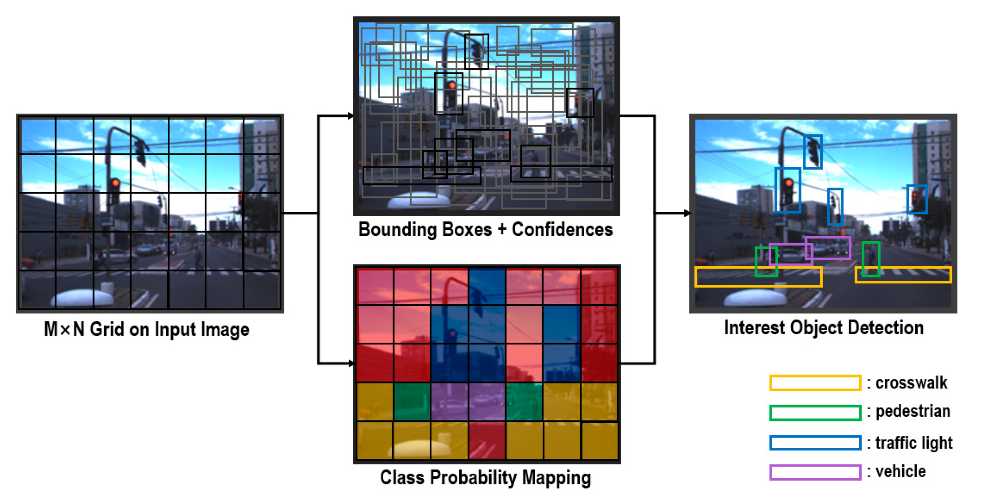
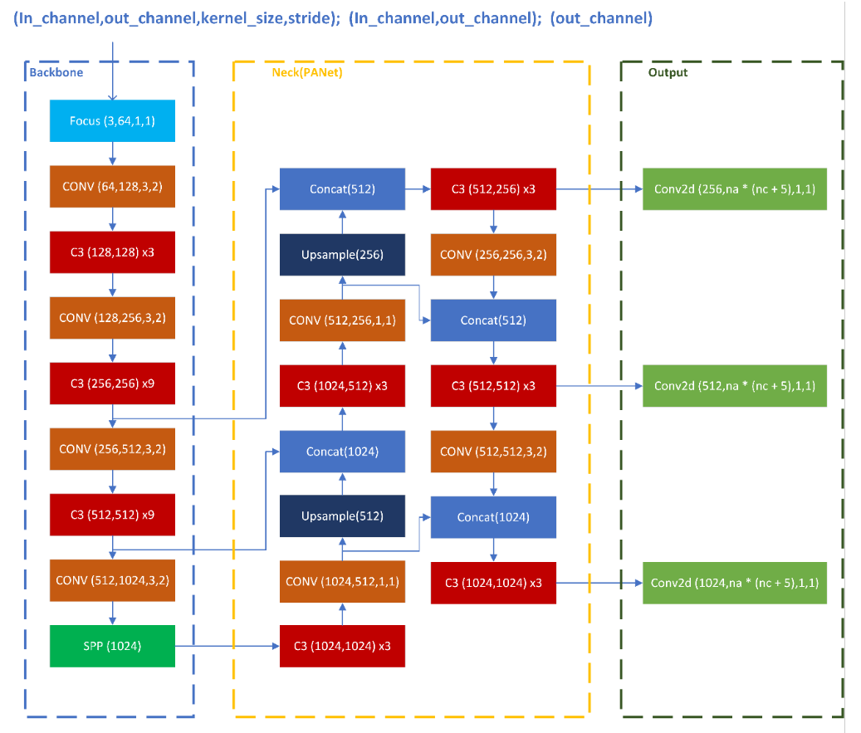
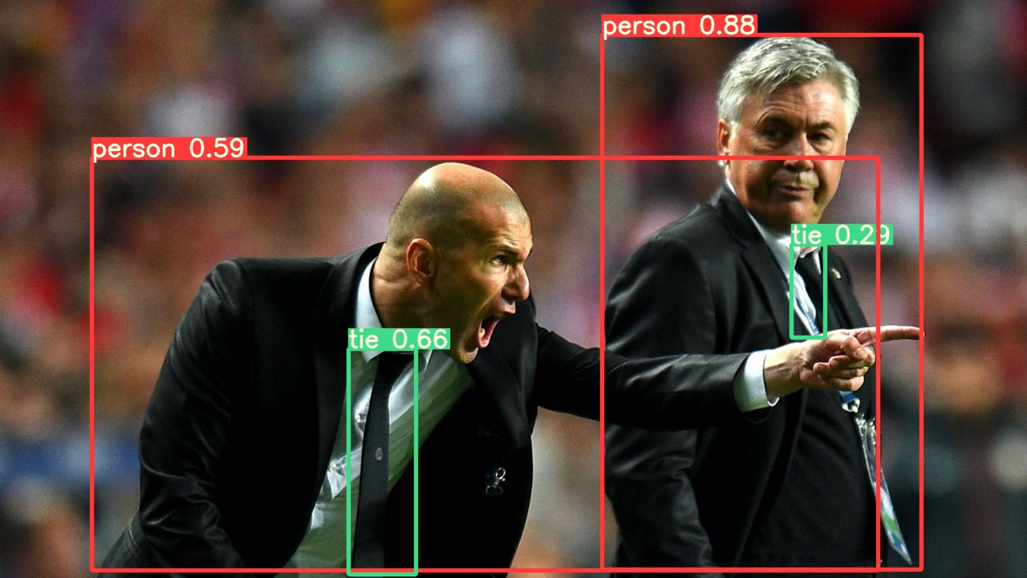
Object Detection with YOLOv5 Model^{[10]}

Slide 12
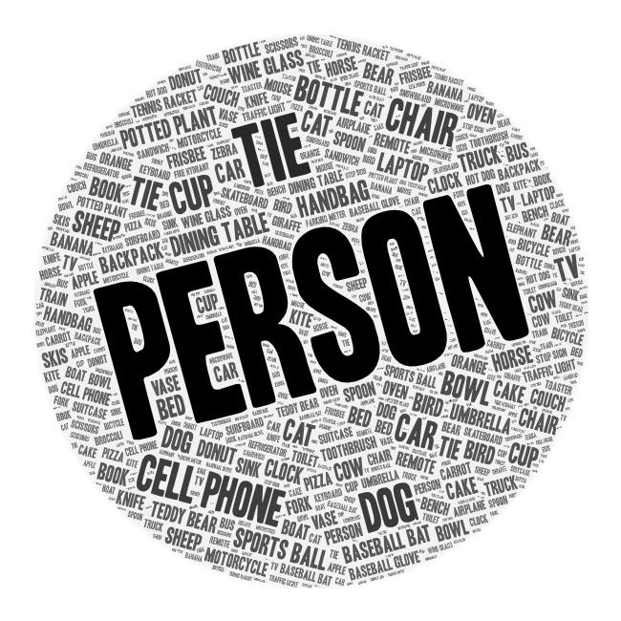
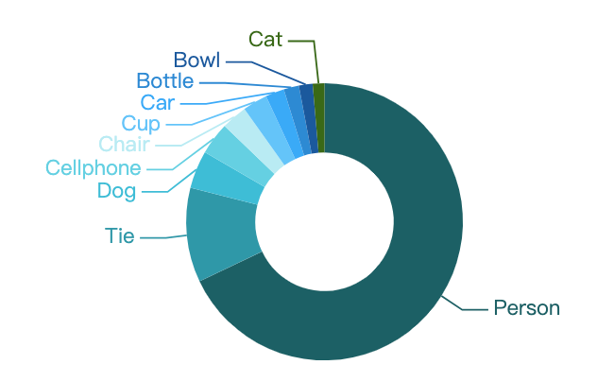
Object Detection Results

Slide 13

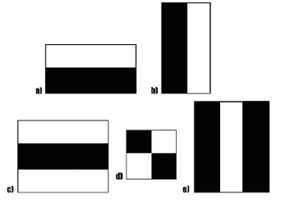
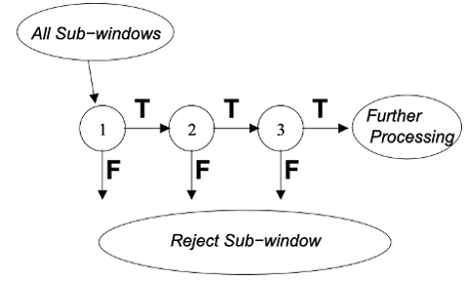

Face Extraction – Haar Cascade Classifier^{[11]}
Haar-like Features:
Compare RGB values with adjacent rectangular areas to extract feature.
Cascaded Classifier:
Input all potential sub-windows into the classifier and reject sub-windows stage by stage.

Slide 14

Face Extraction - Multiple Face Problem
Usually redundant and unrelated faces in each image
Solution:
Include only largest face in each image

Slide 15


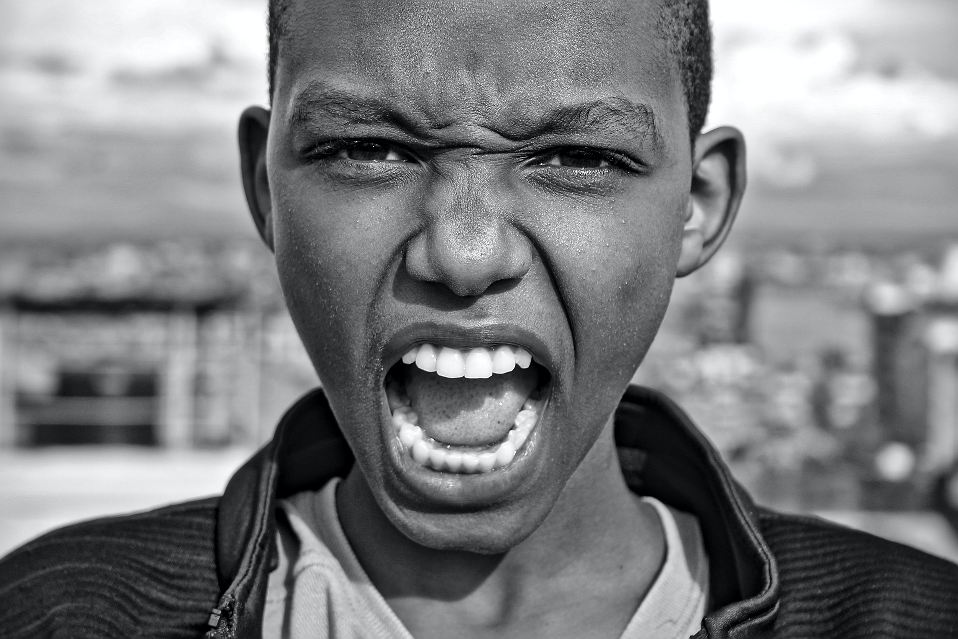
Tag Extraction --
Face Type Detection & Emotion detection Model
This model aims to tackle the task of predicting the age and classifying the gender, race and emotion from facial images.
Pretrained model: DEmo Classi
Backbone: Resnet50
Pretrained dataset:
Fer2013 dataset https://www.kaggle.com/msambare/fer2013
UTK face dataset
https://susanqq.github.io/UTKFace/
Model evaluation on pre-trained dataset:
Results | Precision | Recall | F1-score | Support
Emotion | 0.63 | 0.63 | 0.63 | 3589
Gender | 0.95 | 0.95 | 0.95 | 3556
Race | 0.87 | 0.87 | 0.86 | 3556

Slide 16
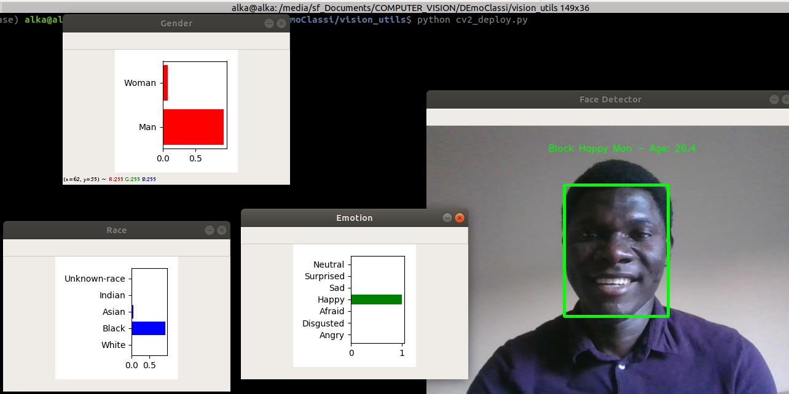
Illustration of Face Type Detection & Emotion detection Model
Image Input
Face Type
Detection
Model
Emotion
Detection
Model
Classification
Classification
Prediction
Race
Gender
Age
Emotion
White
Black
Asian
Indian
Unkown
Male
Female
0-100
Float
Happy
Sad
Afraid
Angry
Disgusted
Surprised
Neutral

Slide 17
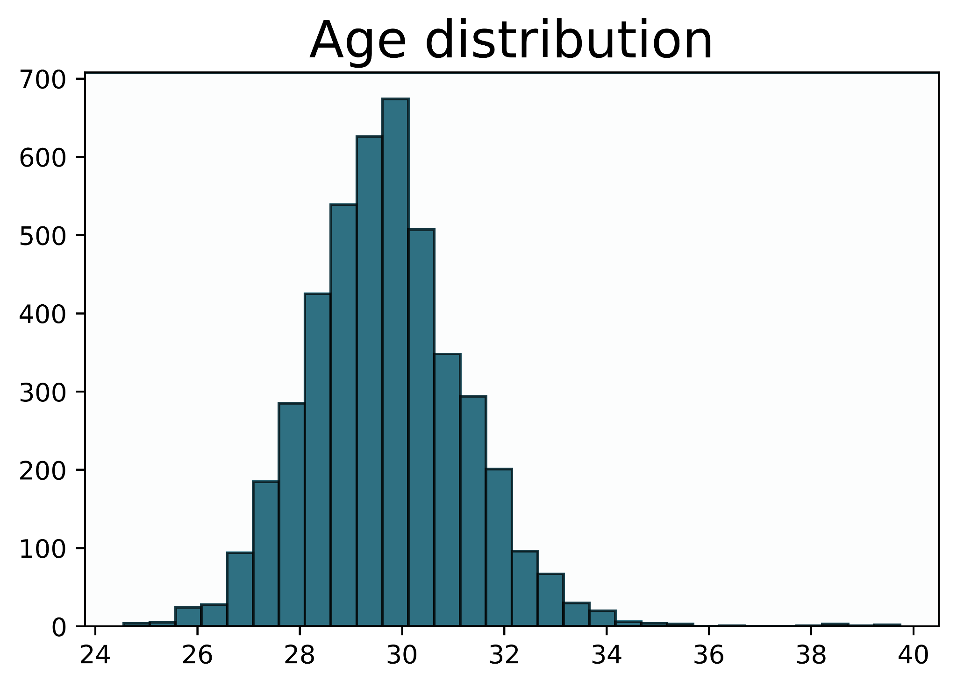
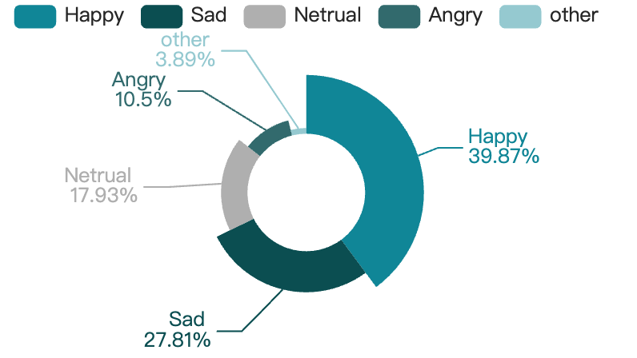
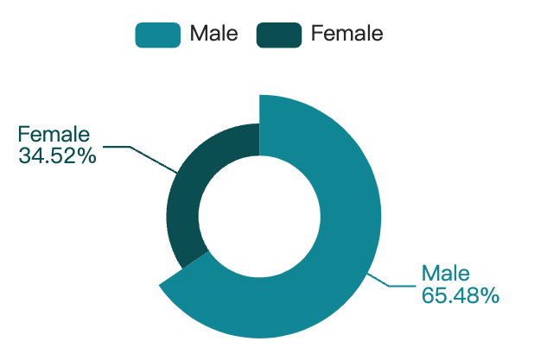
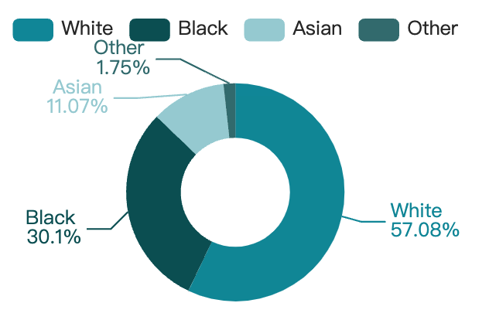
Results of Face Type Detection & Emotion detection Model
Emotion distribution
Gender distribution
Race distribution

Slide 18
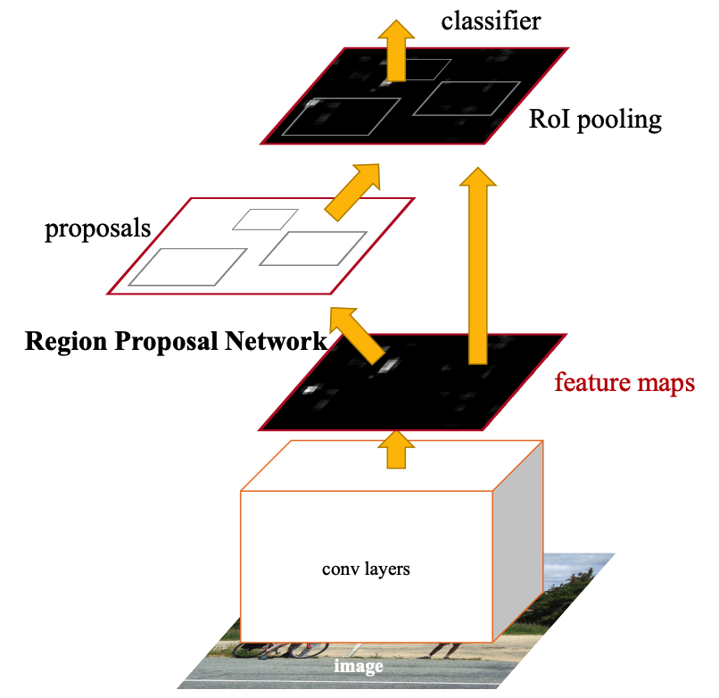

Visual Bert-Based Classifier
VisualBERT^{[12]} integrates BERT^{[8]}, a Transformer-based model for natural language processing, and pretrained object proposals systems Faster-RCNN^{[13]} to be applied to a variety of vision-and-language tasks.
In addition to all the components of BERT, a set of visual embeddings are included in Visual Bert, F, to model an image. Each f ∈ F corresponds to a bounding region in the image, derived from an object detector .
Person 0.996
Water Cup 0.97

Slide 19
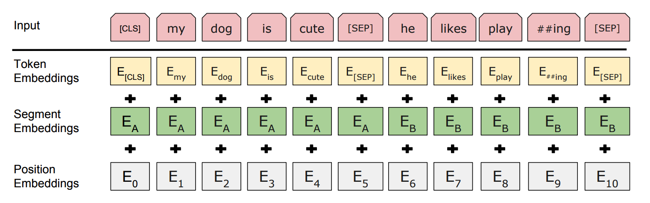
Visual Bert-Based Classifier: Input of Text
All of the subwords in an input sentence are mapped to a set of embeddings, E. Each embedding e ∈ E is computed as the sum of
1) a token embedding et, specific to the subword,
2) a segment embedding es, indicating which part of text the token comes from (e.g., the hypothesis from an entailment pair)
3) a position embedding ep, indicating the position of the token in the sentence.

Slide 20
Visual Bert-Based Classifier
VisualBERT^{[12]} integrates BERT^{[8]}, a Transformer-based model for natural language processing, and pretrained object proposals systems Faster-RCNN^{[13]} to be applied to a variety of vision-and-language tasks.
In addition to all the components of BERT, a set of visual embeddings are included in Visual Bert, F, to model an image. Each f ∈ F corresponds to a bounding region in the image, derived from an object detector .
Person 0.996
Water Cup 0.97

Slide 21
Visual Bert-Based Classifier
Text Description
Race/Gender/Emotion/Objection Tags
Image Regions
Token Embedding
[CLS]
where
my
water
[SEP]
White
Male
Sad
Person
[SEP]
[IMG]
[IMG]
Visual Feature
Embedding
Token
Type
Embedding
A
A
A
A
A
B
B
B
B
B
C
C
Visual Bert Classifier
Non-Hateful
Hateful

Slide 22

03
Performance Evaluation

Slide 23
Result Comparison
Parameters:
Learning Rate = 0.0001 Weight decay = 0.05 Batch Size = 24 Dropout Rate =0.3 Gradient Accumulation Step = 2 Epoch = 50
Model | Accuracy | Recall | Precision
TF-IDF + Logistic Regression | 61.8% | 18.2% | 63.3%
TF-IDF + SVM | 61.3% | 16.8% | 61.6%
TF-IDF + Naive Bayes | 60.0% | 13.2% | 57.1%
TF-IDF + Random Forest | 58.7% | 0.1% | 100%
TF-IDF + K Nearest Neighbor | 58.7% | 57.1% | 0.3%
BERT | 58.3% | 35.5% | 63.6%
Text-CNN | 63.1% | 45.7% | 50.4%
ResNet | 64.5% | 0% | 64.5%
Visual BERT | 58.1% | 42.2% | 50.3%
Visual BERT with labels | 67.3% | 58.8% | 66.0%

Slide 24
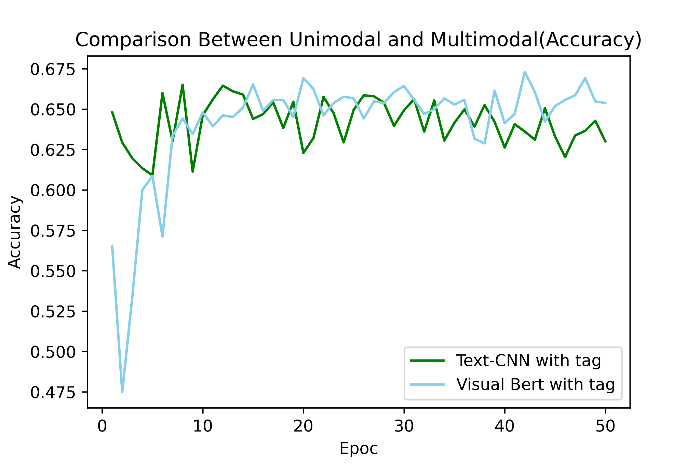
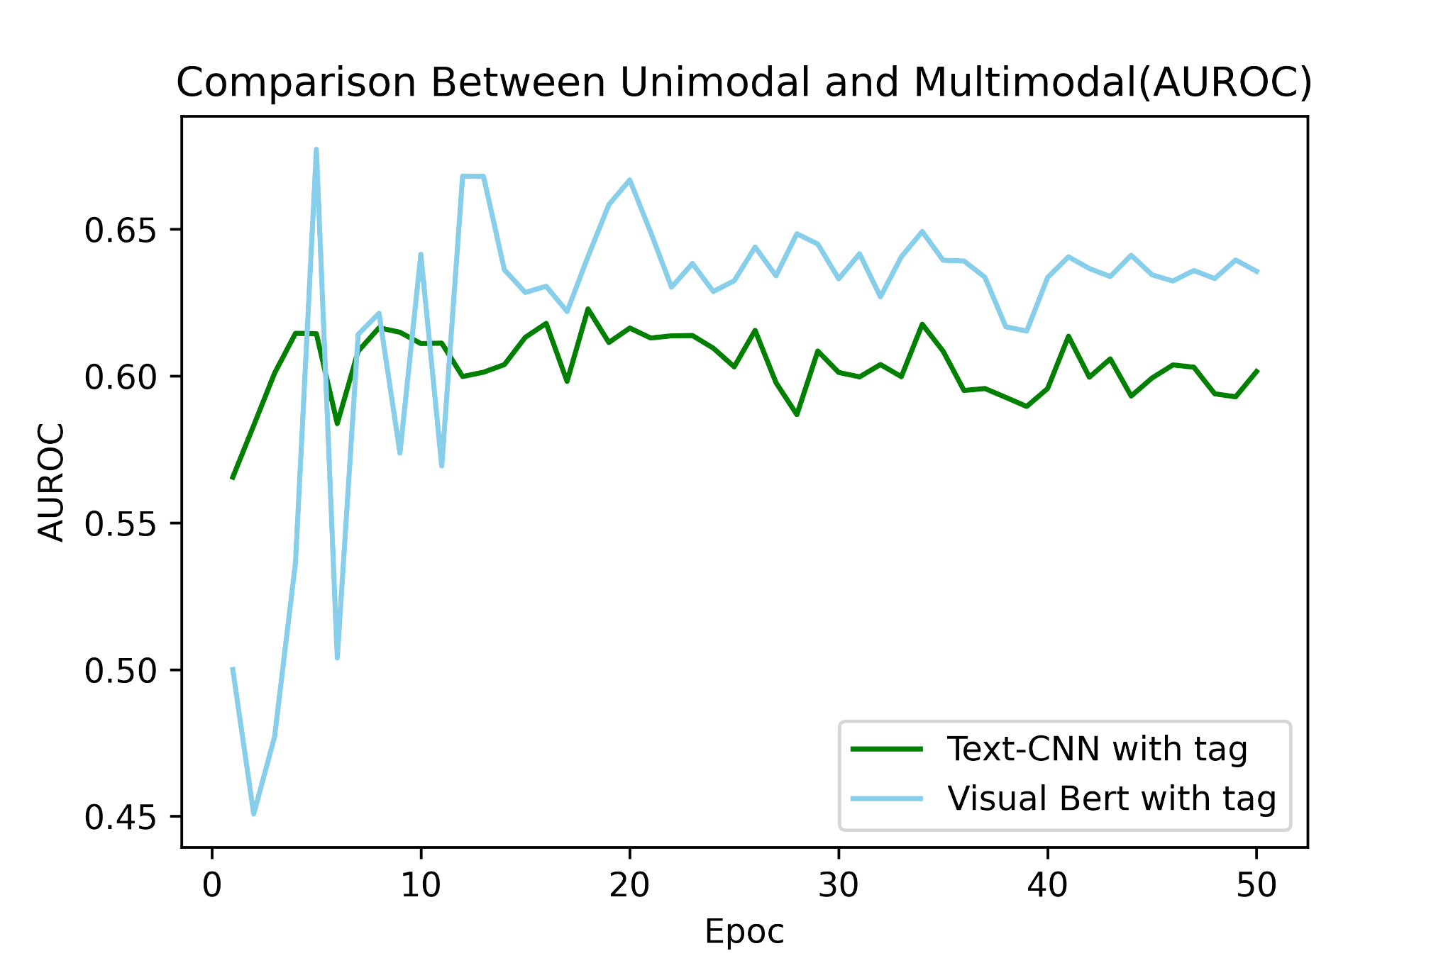
Result Comparison

Slide 25

04
Conclusion & Future Works

Slide 26
Conclusions
In this project, we proposed different kinds of classification models for hateful memes, including text-based unimodal, image-based unimodal and text-image-based multimodal models. However, all these models have performance that is not that satisfactory.
Therefore, we proposed a new model that first extract more labels including objects, human races, genders and emotions to expand our feature vector. The performance increases in terms of accuracy, recall, precision and auroc. This indicates that our attempts to add more tags to construct our new features actually make sense.
However, currently our labels are still not representative especially for objects. We could train more specific models that could detect more important objects instead of using pretrained models by others.
Although finding more representative tags could make effects, the project itself has its limitation. According to the initiator of the project, even manual classification of these memes could only achieve an accuracy of 84%. So unlike traditional image or text classification tasks, meme detection includes some more complicated logic reasoning that is hard for machine to detect.

Slide 27
Future Work
Better Tune our Models
Add Batch Normalization; Increase Dropout Rate;
Run more epoches
Extract Better Labels
Pretrain our own Face Classification Model;
Change Object Detection into Google Entity Detection [13]
Further Process our images
Remove texts from images;
Segment different images in a meme

Slide 28
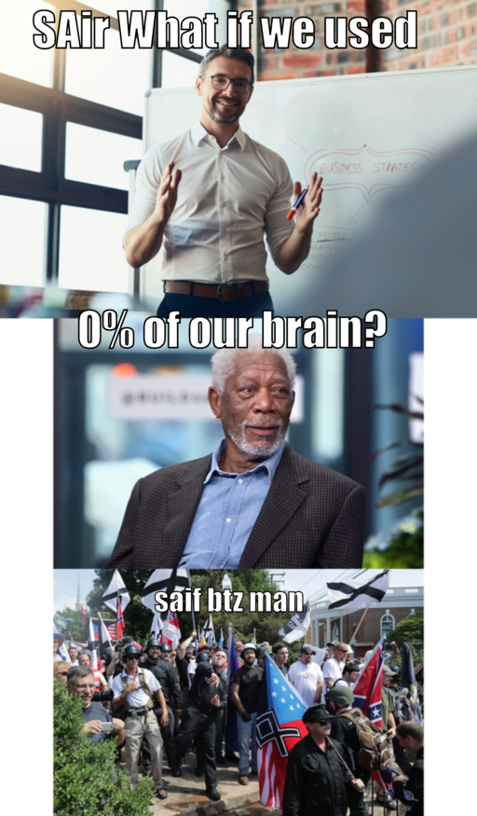
Image Further Processing
Text Removal
Image Segmentation

Slide 29

Web Entity Detection (Provided by Google)
Object Result
Person, Cell phone
Entity Result
Carnival in Rio de Janeiro

Slide 30
References
[1] Firoj Alam, Ferda Ofli, and Muhammad Imran. Crisismmd: Multimodal twitter datasets from natural disasters. In Twelfth International AAAI Conference on Web and Social Media, 2018
[2] Zhu, R. (2020). Enhance multimodal transformer with external label and in-domain pretrain: Hateful meme challenge winning solution. arXiv preprint arXiv:2012.08290.
[3]Constantin, M. G., Pârvu, D. S., Stanciu, C., Ionascu, D., & Ionescu, B. (2021, July). Hateful meme detection with multimodal deep neural networks. In 2021 International Symposium on Signals, Circuits and Systems (ISSCS) (pp. 1-4). IEEE.
[4]Velioglu, R., & Rose, J. (2020). Detecting hate speech in memes using multimodal deep learning approaches: Prize-winning solution to hateful memes challenge. arXiv preprint arXiv:2012.12975.
[5]Wanbo, L., & Suying, L. (2021, May). Research on multi-modal hateful meme detection. In 2021 2nd International Conference on Artificial Intelligence and Information Systems (pp. 1-10).
[6] “TF–IDF.” Wikipedia, Wikimedia Foundation, 11 Feb. 2022, https://en.wikipedia.org/wiki/Tf%E2%80%93idf.
[7] Zhang, Ye, and Byron Wallace. "A sensitivity analysis of (and practitioners' guide to) convolutional neural networks for sentence classification." arXiv preprint arXiv:1510.03820 (2015).
[8] Devlin, Jacob, et al. "Bert: Pre-training of deep bidirectional transformers for language understanding." arXiv preprint arXiv:1810.04805 (2018).
[9] He, Kaiming, et al. “Deep Residual Learning for Image Recognition.” 2016 IEEE Conference on Computer Vision and Pattern Recognition (CVPR), 2016, https://doi.org/10.1109/cvpr.2016.90.
[10] Redmon, Joseph, et al. “You Only Look Once: Unified, Real-Time Object Detection.” 2016 IEEE Conference on Computer Vision and Pattern Recognition (CVPR), 2016, https://doi.org/10.1109/cvpr.2016.91.
[11] Viola, P., and M. Jones. “Rapid Object Detection Using a Boosted Cascade of Simple Features.” Proceedings of the 2001 IEEE Computer Society Conference on Computer Vision and Pattern Recognition. CVPR 2001, https://doi.org/10.1109/cvpr.2001.990517.
[12]Li, L. H., Yatskar, M., Yin, D., Hsieh, C. J., & Chang, K. W. (2019). Visualbert: A simple and performant baseline for vision and language. arXiv preprint arXiv:1908.03557.
[13]Ren, S., He, K., Girshick, R., & Sun, J. (2015). Faster r-cnn: Towards real-time object detection with region proposal networks. Advances in neural information processing systems, 28.

Slide 31
​​
Q & A

Slide 32
Thanks for your listening!
Presented by: Ruitian Wu & Yijia Xue
March 8th, 2022

